Slide 1
Satellite/Aerial Image Retrieval
Kunal Dhande Kunal Kolhatkar
A20369862 A20373885

Slide 2
Resources
Bing Maps Tile System Documentation
Provided pseudocode/logic to calculate quad keys:
http://msdn.microsoft.com/en-us/library/bb259689.aspx
Mapped out our core methodology (explained in next process slide)

Slide 3
TASK
In this assignment, we have to automatically download aerial imagery with maximum resolution available for given two latitude and longitude bounding box using Bing maps tile system.

Slide 4
Approach
Starting with the two Lat/Long points, we found the X,Y coordinates of tile for first point (Starting tile) and second point(Ending tile) and then the highest common zoom level for these two tiles.
Now using this common zoom level we found quadkeys of all the tiles in between the starting and ending tile.
Using these quadkey we downloaded corresponding image from - http://h0.ortho.tiles.virtualearth.net/tiles/h<quadkeys>.jpeg?g=135
Then starting with the first image, concatenated all these images and formed the final Image which will have both these two points(Bounding box)

Slide 5
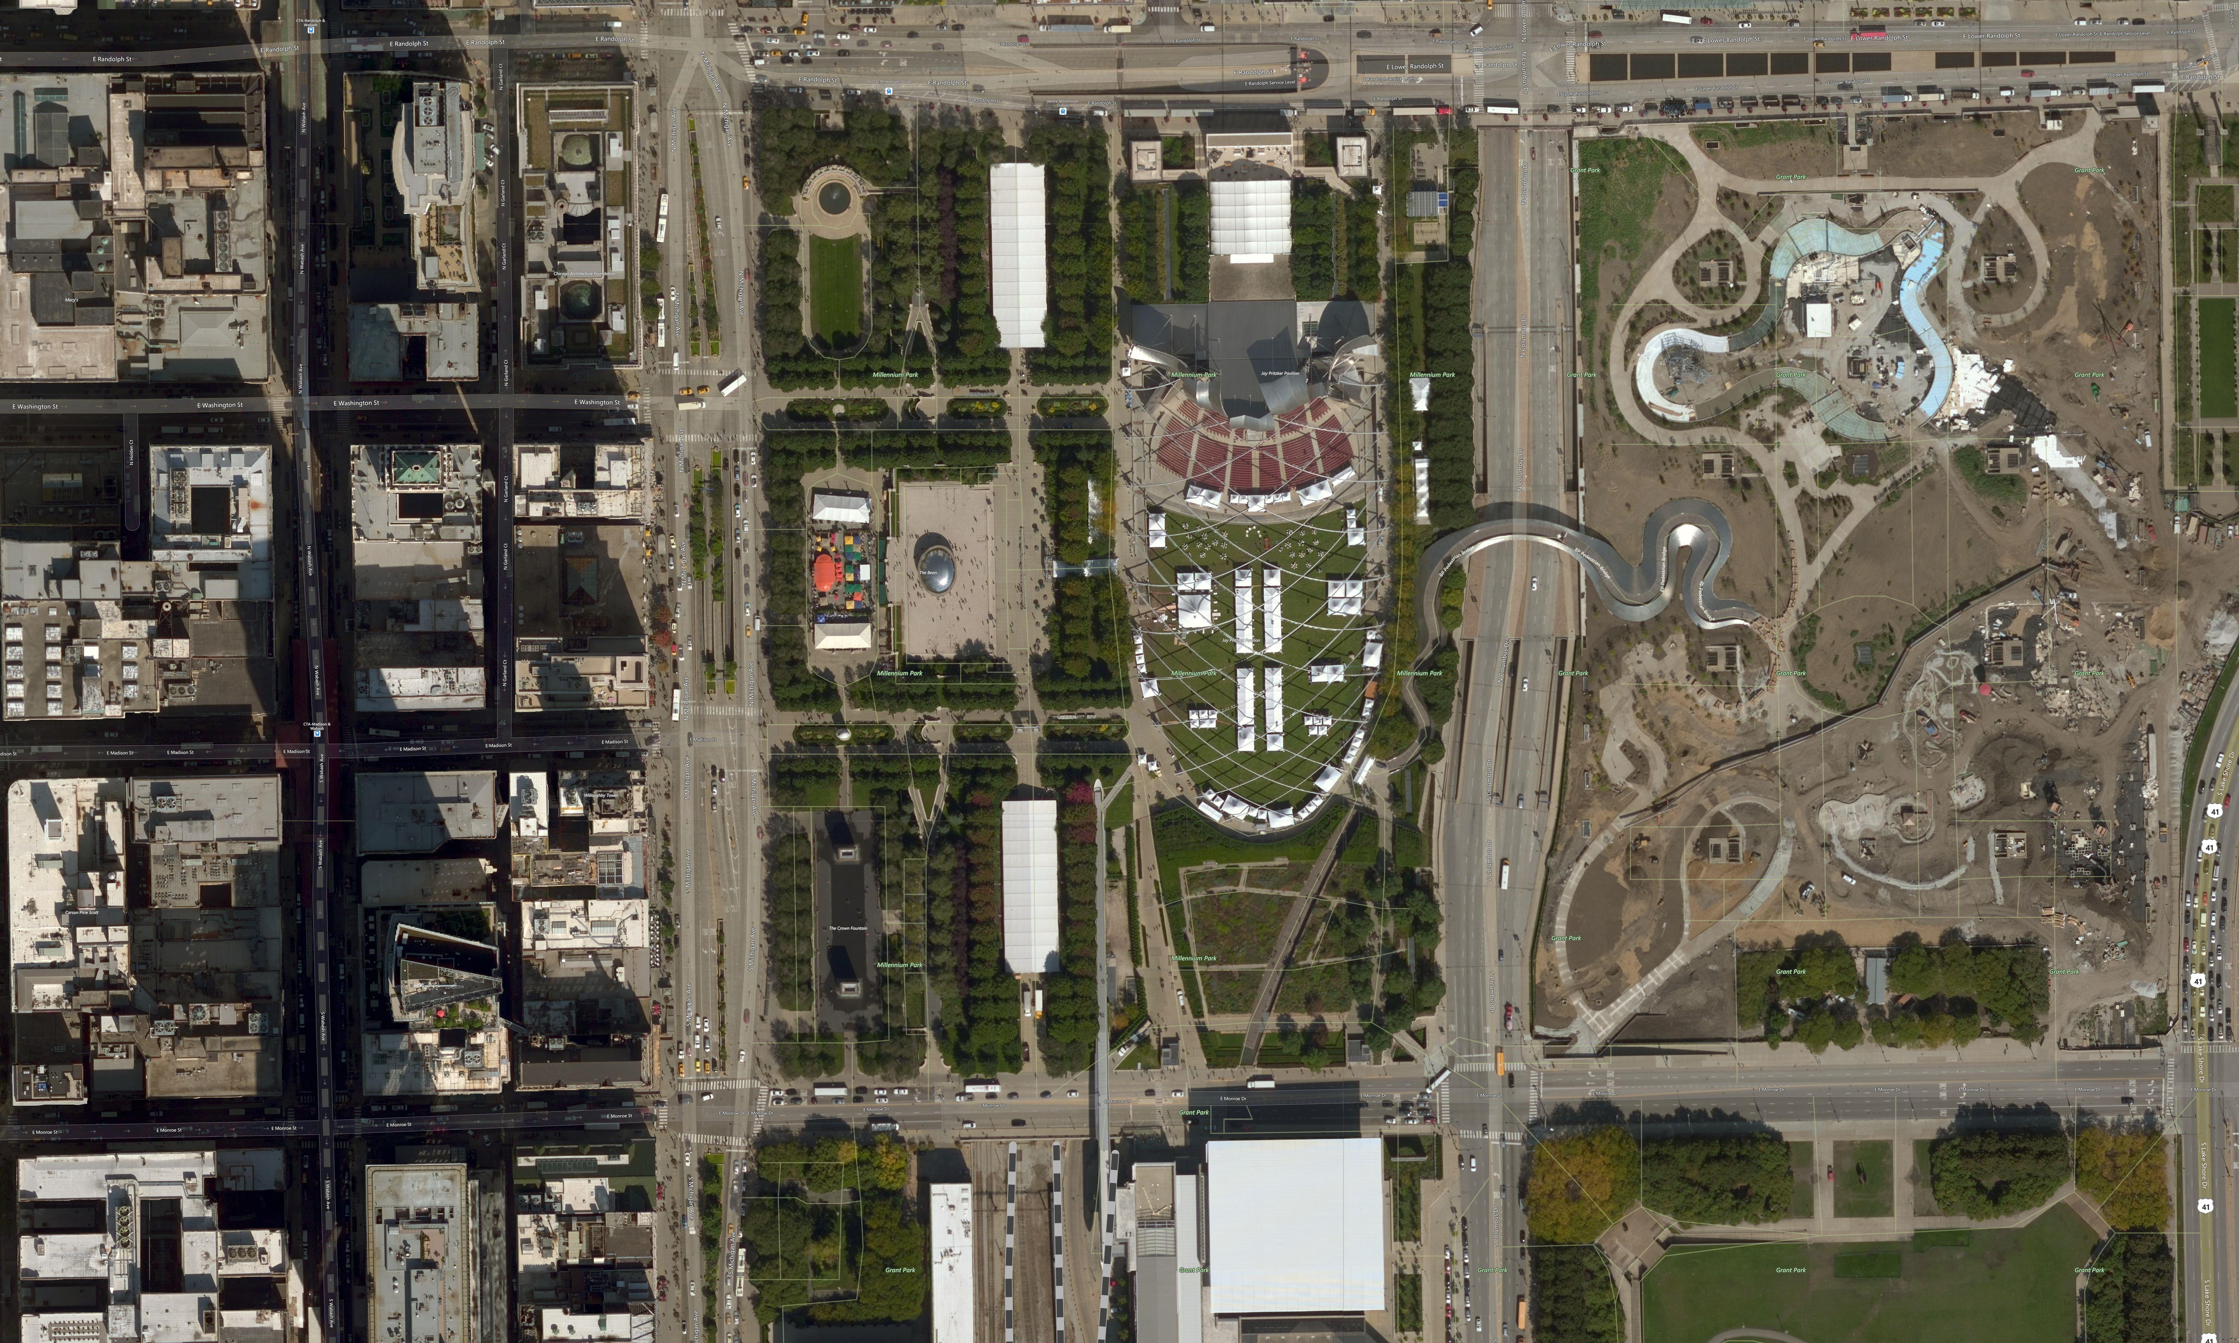
Results
Input:
2 bounding coordinates (lat1, long1, lat2, long2)
Type in terminal to run the code:
python index.py 41.884423 -87.627599 41.880142 -87.617342
Output -
Calculated quadkey to query Bing system
030222231030131
Saves output image as “image.jpeg” under the same directory

Slide 6
REFERENCES
Bing Maps Tile System, “http://msdn.microsoft.com/en-us/library/bb259689.aspx”

